Slide 1
Chapter 4 Online Consumer Behavior, Market Research, and Advertisement

Slide 2
LEARNING OBJECTIVES
Understand the decision-making process of consumer purchasing online.
Describe how companies are building one-to-one relationships with customers.
Explain how personalization is accomplished online.
Discuss the issues of e-loyalty and e-trust in EC.
Describe consumer market research in EC.
Describe the objectives of Web advertising and its characteristics.

Slide 3
LEARNING OBJECTIVES
Describe the major advertising methods used on the Web.
Understand how advertising is done in social networks and the Web 2.0 environment.
Describe various online advertising strategies and types of promotions.
Describe permission marketing, ad management, localization, and other advertising-related issues.

Slide 4
LEARNING ABOUT CONSUMER PURCHASING ONLINE
A GENERIC PURCHASING-DECISION MODEL
Need identification
Information search
product brokering
Deciding what product to buy.
merchant brokering
Deciding from whom (from what merchant) to buy products.
Evaluation of alternatives
Purchase decision and delivery
Postpurchase behavior

Slide 5
LEARNING ABOUT CONSUMER PURCHASING ONLINE
CUSTOMER DECISION SUPPORT IN WEB PURCHASING
PLAYERS IN THE CONSUMER DECISION PROCESS
Initiator
Influencer
Decider
Buyer
User
ONE-TO-ONE MARKETING

Slide 6
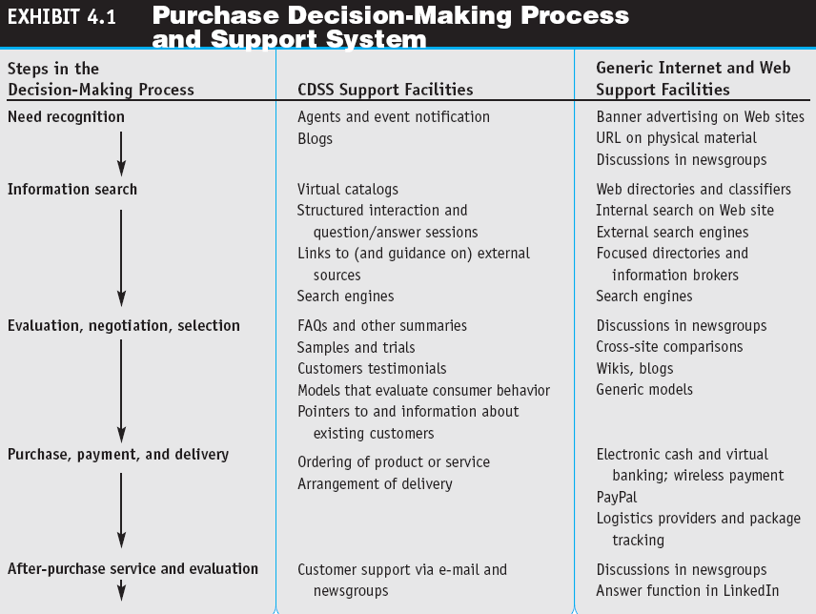

Slide 7
PERSONALIZATION, LOYALTY, SATISFACTION, AND TRUST IN EC
personalization
The matching of services, products, and advertising content with individual consumers and their preferences.
user profile
The requirements, preferences, behaviors, and demographic traits of a particular customer.

Slide 8
PERSONALIZATION, LOYALTY, SATISFACTION, AND TRUST IN EC
The major strategies used to compile user profiles include:
Solicit information directly from the user
Observe what people are doing online
cookie
A data file that is placed on a user’s hard drive by a remote Web server, frequently without disclosure or the user’s consent, that collects information about the user’s activities at a site.
Build from previous purchase patterns
Perform marketing research

Slide 9
PERSONALIZATION, LOYALTY, SATISFACTION, AND TRUST IN EC
Make inferences
behavioral targeting
The use of information collected on an individual’s Internet browsing behavior to select which advertisements to display to that individual.
CUSTOMER LOYALTY
e-loyalty
Customer loyalty to an e-tailer or loyalty programs delivered online or supported electronically.

Slide 10
PERSONALIZATION, LOYALTY, SATISFACTION, AND TRUST IN EC
SATISFACTION IN EC
TRUST IN EC
trust
The psychological status of willingness to depend on another person or organization.
EC Trust Models

Slide 11
MARKET RESEARCH FOR EC
METHODS FOR CONDUCTING MARKET RESEARCH ONLINE
WHAT ARE MARKETERS LOOKING FOR IN EC MARKET RESEARCH?
MARKET SEGMENTATION RESEARCH

Slide 12
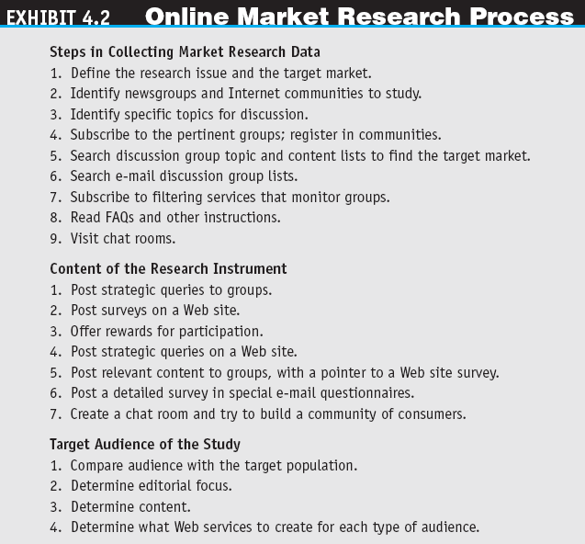
FYP

Slide 13
MARKET RESEARCH FOR EC
MARKET RESEARCH FOR ONE-TO-ONE
Direct Solicitation of Information
Implementing Web-Based Surveys
Online Focus Groups
Hearing Directly from Customers
Data Collection in the Web 2.0 Environment
Discussion forums, polling, blogging, chatting, live chat, chatterbots, collective wisdom for intelligence, find expertise, folksonomy, data in videos, photos, and other rich media

Slide 14
MARKET RESEARCH FOR EC
Observing Customers’ Movements Online
transaction log
A record of user activities at a company’s Web site.
clickstream behavior
Customer movements on the Internet.

Slide 15
MARKET RESEARCH FOR EC
Cookies, Web Bugs, and Spyware
Web bugs
Tiny graphics files embedded in e-mail messages and in Web sites that transmit information about users and their movements to a Web server.
spyware
Software that gathers user information over an Internet connection without the user’s knowledge.

Slide 16
MARKET RESEARCH FOR EC
Analysis of B2C Clickstream Data
clickstream data
Data that occur inside the Web environment; they provide a trail of the user’s activities (the user’s clickstream behavior) in the Web site.
Web mining
The use of data mining techniques for discovering and extracting information from Web documents and Web usage.

Slide 17
MARKET RESEARCH FOR EC
collaborative filtering
A market research and personalization method that uses customer data to predict, based on formulas derived from behavioral sciences, what other products or services a customer may enjoy; predictions can be extended to other customers with similar profiles.
Legal and Ethical Issues in Collaborative Filtering

Slide 18
MARKET RESEARCH FOR EC
LIMITATIONS OF ONLINE MARKET RESEARCH AND HOW TO OVERCOME THEM
Too much data to analyze, accuracy of responses, sharing of computers, etc..
BIOMETRIC MARKETING
biometrics
An individual’s unique physical or behavioral characteristics that can be used to identify an individual precisely (e.g. fingerprints).

Slide 19
WEB ADVERTISING
OVERVIEW OF WEB ADVERTISING
interactive marketing
Online marketing, facilitated by the Internet, by which marketers and advertisers can interact directly with customers, and consumers can interact with advertisers/vendors.

Slide 20
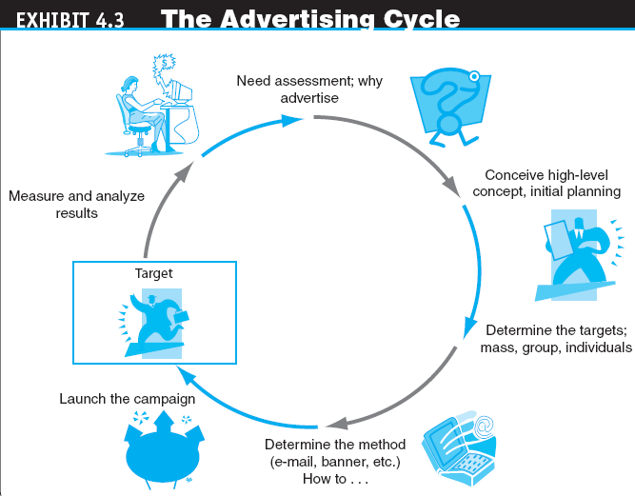

Slide 21
WEB ADVERTISING
SOME BASIC INTERNET ADVERTISING TERMINOLOGY
ad views
The number of times users call up a page that has a banner on it during a specific period; known as impressions or page views.
button
A small banner that is linked to a Web site. It can contain downloadable software.

Slide 22
WEB ADVERTISING
click (click-through or ad click)
A count made each time a visitor clicks on an advertising banner to access the advertiser’s Web site.
click-through rate
The percentage of visitors who are exposed to a banner ad and click on it.
click-through ratio
The ratio between the number of clicks on a banner ad and the number of times it is seen by viewers; measures the success of a banner in attracting visitors to click on the ad.

Slide 23
WEB ADVERTISING
conversion rate
The percentage of clickers who actually make a purchase.
CPM (cost per thousand impressions)
The fee an advertiser pays for each 1,000 times a page with a banner ad is shown.
hit
A request for data from a Web page or file.

Slide 24
WEB ADVERTISING
page
An HTML (Hypertext Markup Language) document that may contain text, images, and other online elements, such as Java applets and multimedia files. It can be generated statically or dynamically.
stickiness
Characteristic that influences the average length of time a visitor stays in a site.

Slide 25
WEB ADVERTISING
unique visits
A count of the number of visitors entering a site, regardless of how many pages are viewed per visit.
visit
A series of requests during one navigation of a Web site; a pause of a certain length of time ends a visit.

Slide 26
WEB ADVERTISING
Advertising Online and Its Advantages
Cost
Richness of format
Personalization
Timeliness
Location-basis
Linking
Digital branding

Slide 27
ONLINE ADVERTISING METHODS
BANNERS
banner
On a Web page, a graphic advertising display linked to the advertiser’s Web page.
keyword banners
Banner ads that appear when a predetermined word is queried from a search engine.
random banners
Banner ads that appear at random, not as the result of the user’s action.

Slide 28
ONLINE ADVERTISING METHODS
Benefits of Banner Ads
The major benefit of banner ads is that, by clicking on them, users are directly transferred to the shopping page of an advertiser’s site.
The ability to customize them for individual surfers or a market segment of surfers.
Limitations of Banner Ads
The major disadvantage of banners is their cost
A limited amount of information can be placed on the banner

Slide 29
ONLINE ADVERTISING METHODS
pop-up ad
An ad that appears in a separate window before, after, or during Internet surfing or when reading e-mail.
pop-under ad
An ad that appears underneath the current browser window, so when the user closes the active window the ad is still on the screen.

Slide 30
ONLINE ADVERTISING METHODS
E-MAIL ADVERTISING
E-Mail Hoaxes
Fraud
E-Mail Advertising Methods and Successes
CLASSIFIED ADS

Slide 31
ONLINE ADVERTISING METHODS
SEARCH ENGINE ADVERTISEMENT
URL Listing
Keyword Advertising
search engine optimization (SEO)
The craft of increasing site rank on search engines; the optimizer uses the ranking algorithm of the search engine (which may be different for different search engines) and best search phases, and tailors the ad accordingly.
Google: The Online Advertising King

Slide 32
ONLINE ADVERTISING METHODS
viral marketing
Word-of-mouth method by which customers promote a product or service by telling others about it.

Slide 33
ADVERTISING IN SOCIAL NETWORKS AND THE WEB 2.0 ENVIRONMENT
social network advertising
Online advertising that focuses on social networking sites.
Types of Social Network Advertising
Direct advertising that is based on your network of friends
Direct advertising placed on your social network site
Indirect advertising by creating “groups” or “pages”
Sponsored Reviews by Bloggers

Slide 34
ADVERTISING IN SOCIAL NETWORKS AND THE WEB 2.0 ENVIRONMENT
ADVERTISING IN CHAT ROOMS AND FORUMS
VIDEO ADS ON THE WEB AND IN SOCIAL NETWORKING
Video Ads
Tracking the Success of an Online Video Campaign
Web video analytics
A way of measuring what viewers do when they watch an online video.
VIRAL MARKETING IN SOCIAL NETWORKS

Slide 35
ADVERTISING STRATEGIES
affiliate marketing
A marketing arrangement by which an organization refers consumers to the selling company’s Web site.
ADS AS A COMMODITY (PAYING PEOPLE TO WATCH ADS)
SELLING SPACE BY PIXELS

Slide 36
ADVERTISING STRATEGIES
PERSONALIZED ADS AND OTHER PERSONALIZATION
Webcasting
A free Internet news service that broadcasts personalized news and information, including seminars, in categories selected by the user.
ONLINE EVENTS, PROMOTIONS, AND ATTRACTIONS
Live Web Events

Slide 37
SPECIAL ADVERTISING TOPICS
PERMISSION ADVERTISING
spamming
Using e-mail to send unwanted ads (sometimes floods of ads).
permission advertising (permission marketing)
Advertising (marketing) strategy in which customers agree to accept advertising and marketing materials (known as “opt-in”).

Slide 38
SPECIAL ADVERTISING TOPICS
ADVERTISEMENT AS A REVENUE MODEL
MEASURING ONLINE ADVERTISING’S EFFECTIVENESS
MOBILE MARKETING AND ADVERTISING
mobile advertising (m-advertising)
Ads sent to and presented on mobile devices.

Slide 39
SPECIAL ADVERTISING TOPICS
AD CONTENT
SOFTWARE AGENTS IN MARKETING AND ADVERTISING APPLICATIONS
localization
The process of converting media products developed in one environment (e.g. country) to a form culturally and linguistically acceptable in environments outside the original target market.

Slide 40
MANAGERIAL ISSUES
Do we understand our customers?
Who will conduct the market research?
Are customers satisfied with our Web site?
How can we use social networks for advertising?
How do we decide where to advertise?
What is our commitment to Web advertising, and how will we coordinate Web and traditional advertising?

Slide 41
MANAGERIAL ISSUES
Should we integrate our Internet and non-Internet marketing campaigns?
What ethical issues should we consider?
Are any metrics available to guide advertisers?
Which Internet marketing/advertising channel should you use?

